Slide 1


Customer Shopping Behavior Analysis
Data-Driven Insights for Revenue Optimization
Naushad Alam | Data Analyst

Slide 2

Project Overview
Objective
Dataset
Analyze customer shopping behavior to surface purchasing patterns, demographic effects, and engagement levers that drive revenue and inform marketing strategy.
3,900 customers • 18 features • Retail customer dataset (transactions, demographics, shipping, subscription status)

Slide 3

Tools & Techniques
Python (Pandas) — data cleaning, aggregation, window functions
MySQL — extraction and joins across transaction tables
Power BI & Excel — interactive dashboards and exploratory analysis
Techniques: segmentation, cohort analysis, AOV calculations

Slide 4

Revenue Contribution by Gender
Key insight: 68% of total revenue comes from male customers vs 32% from female customers.
Business impact
Next analysis
Run targeted campaigns for high-value male segments to drive immediate revenue.
Segment male cohorts by product category to find highest-LTV groups.

Slide 5
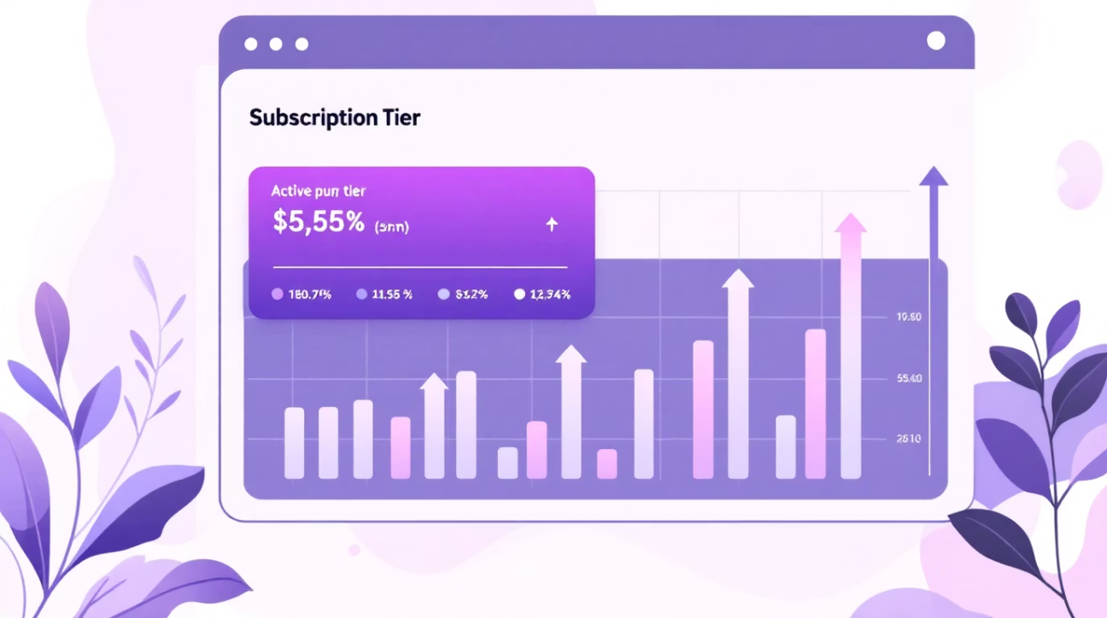

Subscription Impact
Key insight: Customers with active subscriptions show higher purchase frequency and contribute a disproportionate share of revenue.
Higher average order value and repeat purchase rate among subscribers
Subscription upsell and retention can materially increase lifetime value
Recommendation: Run targeted trials and limited-time discounts to convert high-frequency non-subscribers.
Subscription programs represent a high-impact lever for improving customer lifetime value (CLV).

Slide 6

Customer Segmentation
Segmentation logic (purchase-based):
New = 0 previous purchases
Returning = 1–5 purchases
Loyal = 6+ purchases
New Customers
Returning Customers
Loyal Customers
Low revenue share today — opportunity for onboarding offers.
Stable contributors — effective targets for cross-sell.
Highest value segment — prioritize retention and exclusive benefits.
Loyal customers represent the highest-value segment and should be prioritized for retention programs.

Slide 7


Shipping Preference Analysis
Key insight: Customers selecting faster shipping options (Express, Next Day Air) demonstrate higher average order values.
Customers choosing premium shipping have higher AOV and repeat purchase rates.
Promoting premium shipping at checkout increases order value without large discounts.
Opportunity: promote premium shipping upsells at checkout.
Action: A/B test premium shipping upsell copy and placement to measure incremental AOV uplift.

Slide 8

Revenue by Age Group
Key insight: Middle-aged cohorts contribute the largest share of revenue — they show higher purchasing power and frequency. Customers aged 26–45 contribute the largest share of revenue.
Marketing focus
Concentrate promotions and premium product placement on high-spending age segments.
Growth opportunity
Invest in nurturing strategies for younger cohorts to increase lifetime value over time.

Slide 9
Top Products & Categories
Key insight: Apparel categories — particularly Clothing and Footwear — drive the majority of purchase volume and revenue.
Category Performance Breakdown:
Clothing — highest purchase volume
Footwear — strong secondary demand
Accessories — consistent niche demand

Slide 10

Strategic Business Recommendations
1
1. Prioritize high-value male segments
Run targeted creative and product-focused campaigns to capture immediate revenue gains (68% current share).
2
2. Increase subscription adoption
Introduce time-limited incentives and onboarding nudges to convert high-frequency buyers.
3
3. Retain loyal customers
Deploy tiered loyalty benefits and early access promotions to protect LTV.
4
4. Promote premium shipping
A/B test shipping upsells to capture higher AOV from customers preferring faster delivery.
5
5. Optimize inventory & promos
Focus merchandising and budget on top-performing categories identified in analysis.
Next steps: run segmented campaign pilots, measure lift (AOV, conversion, retention), and iterate on personalization strategy.

